Slide 1
Job Market Analysis
Analysis of Job Postings, Salaries, Industries,
Companies and Skills.
Power BI Internship Project
Submitted by: Rigzen Angmo
Team Id: PTID-CDA-SEP-26-11200-A – CDA
Project Id: PRDA-04: Job Market Analysis

Slide 2
Objectives
The main objective is to understand where the job opportunities are and which roles and skills are most in demand.
The analysis also compares salary, location, industry, company, and qualification.
The dashboard is designed to provide useful information for job seekers.
Understand the job market and provide useful suggestions.

Slide 3
Data Preparation
The dataset contains 742 job postings with 42 original columns.
After completely removing the empty FIELD4 column, I worked with 41 useful features.
Missing and invalid values were cleaned where required to make the data suitable for analysis.
A State column was created from state abbreviations such as CA, MA, and NY to make the dashboard easier
to understand.
A separate Skill Analysis table was created by unpivoting the skill columns.
The Skill Analysis table was then connected to the main job-posting table through a relationship in Model
View.
This relationship allows skill selections, such as Python or SQL, to interact with the other dashboard visuals.

Slide 4
Dashboard Overview
The dataset contains 742 total job postings, with an overall average salary of $101.5K.
The highest recorded salary is $254K, while the lowest is $15.5K.
Data Scientist is the most common job title, with 313 postings.
These KPIs provide a quick overview of the job market before looking at the detailed charts.

Slide 5
Job Title Analysis
Top 5 Job Titles by Job Vacancies Insight
Job Title | Job Postings
Data Scientist | 313
Other Scientist | 139
Data Engineer | 119
Analyst | 101
Machine Learning Engineer | 22
Data Scientist is the most in-demand role with 313 postings.
It is followed by Other Scientist with 139, Data Engineer with 119, and Analyst with 101 postings.
This shows strong demand for data-focused and analytical roles.

Slide 6
State Analysis
Top 5 States by Job Postings
State | Job Postings
California | 152
Massachusetts | 103
New York | 72
Virginia | 41
Illinois | 4
California has the highest number of job postings with 152, followed by Massachusetts with 103.
New York has 72 postings, while Virginia and Illinois have 41 and 40 respectively.
This shows that job opportunities are concentrated in a few major states.
Change I made: The dataset originally had state abbreviations such as CA, MA, NY.
I created a new State column with full names:
CA → California
MA → Massachusetts
NY → New York
etc.

Slide 7
Industries Analysis
Top Industries by Job Vacancies
Industry | Job Postings
Biotech & Pharmaceuticals | 112
Insurance Carriers | 63
Computer Hardware & Software | 59
IT Services | 50
Health Care Services & Hospitals | 49
Biotech & Pharmaceuticals has the highest number of overall postings with 112.
It is followed by Insurance Carriers with 63 and Computer Hardware & Software with 59.
This indicates strong demand for data-related roles across healthcare, technology, and insurance industries.

Slide 8
Company Analysis
Top Companies by Job Vacancies
Company | Job Postings
MassMutual | 14
Reynolds American | 14
Takeda Pharmaceuticals | 14
Software Engineering Institute | 11
Liberty Mutual Insurance | 10
PNNL | 10
The highest company has around 10-14 Postings each.
MassMutual, Reynolds American, and Takeda Pharmaceuticals each have 14 job postings.
Software Engineering Institute has 11, while Liberty Mutual Insurance has 10.
The analysis helps job seekers identify companies with multiple opportunities.

Slide 9
Skill Analysis
Most In-Demand Skills
Skill | Job Postings
Python | 390
EXL | 385
SQL | 380
AWS | 180
Apache Spark | 170
Python, Excel, and SQL are the most frequently required skills in the dataset.
Other important skills include AWS, Apache Spark, Tableau, and Hadoop.
The separate Skill Analysis table allows us to examine which skills are required for different job titles.
The interactive relationship also allows users to click a skill and see its impact on other visuals.

Slide 10
Salary and Qualification
The overall average salary is $101.5K, with salaries ranging from $15.5K to $254K.
Salary varies across different job titles, states, and qualification levels.
The dashboard uses average salary because it gives a better idea of the typical salary
for a job or category than total salary.
Salary Overview
Minimum salary: $15.5K
Average salary: $101.5K
Maximum salary: $254K
Important point: The salary column Avg_Salary(K) is already in thousands (K).

Slide 11
Key Insights
Data Scientist is the most common job title with 313 postings.
California has the highest number of postings with 152.
Biotech & Pharmaceuticals has the highest overall industry vacancies with 112.
Python, Excel and SQL are the top skills.
Overall average salary is $101.5K.
Maximum salary is $254K.
Minimum salary is $15.5K.
The top companies have around 10–14 job postings each.
Job opportunities are concentrated in certain states and industries.

Slide 12
Recommendation
Job seekers should focus on developing Python, SQL, and Excel skills.
Learning additional tools such as AWS, Spark, and Tableau can improve opportunities.
Candidates can focus their search on high-demand states and industries.
Explore industries such as:
  Biotech & Pharmaceuticals
  Insurance
  IT
  Healthcare
Do not look only at salary; also consider skills, qualification, location and job role.

Slide 13
Conclusion
The Job Market Analysis shows that:
Data Scientist is the most demanded job title.
California has the highest number of job postings.
Biotech & Pharmaceuticals has the highest industry vacancies.
Python, Excel and SQL are the most important skills in the dataset.
Average salary is around $101.5K.
Salary differs according to job role, location and qualification.
Overall, the analysis helps job seekers understand where the opportunities
are and which skills they should focus on.

Slide 14
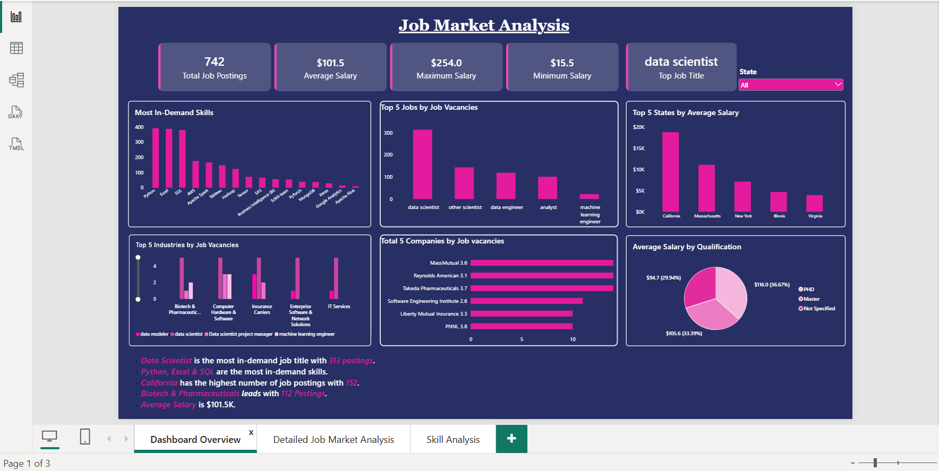
Screenshots

Slide 15
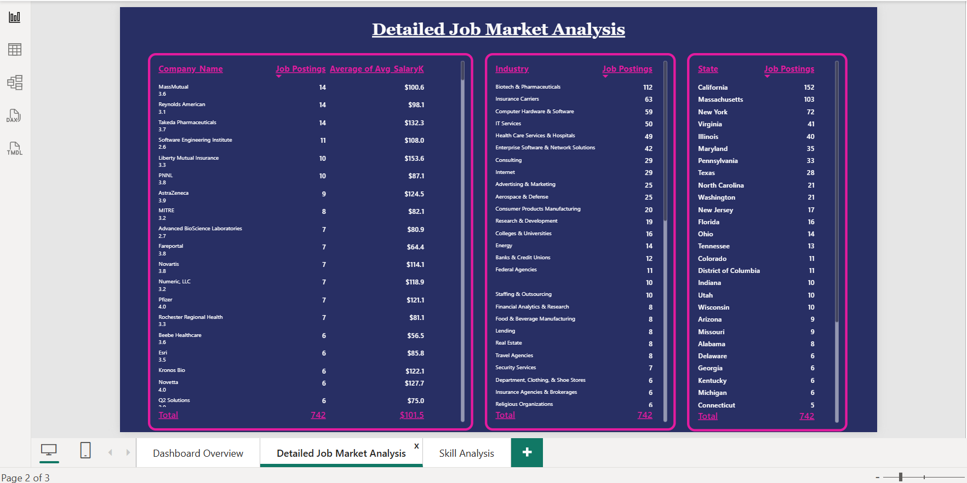

Slide 16
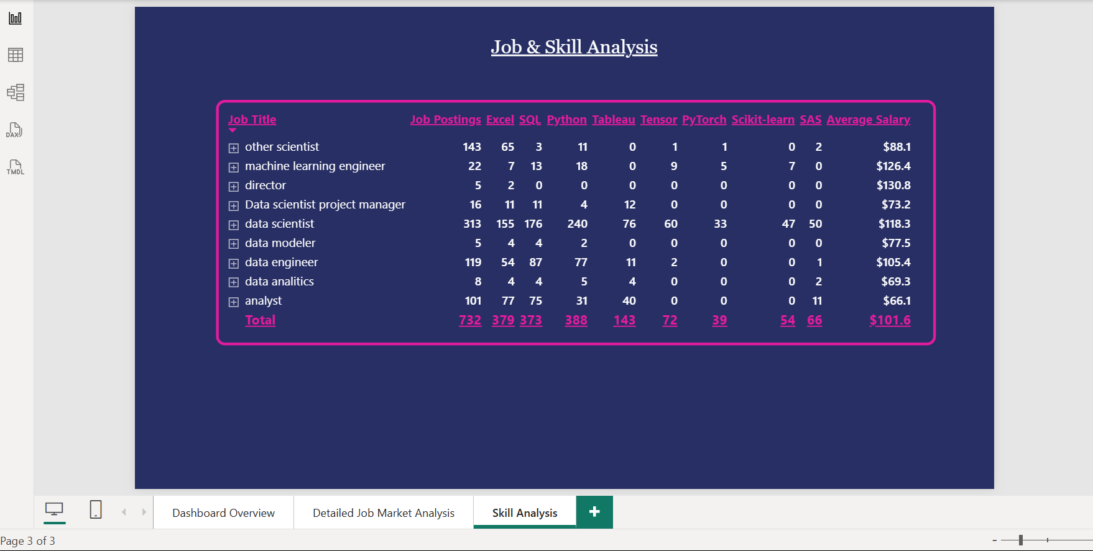

Slide 17


